Slide 1
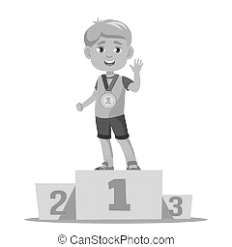
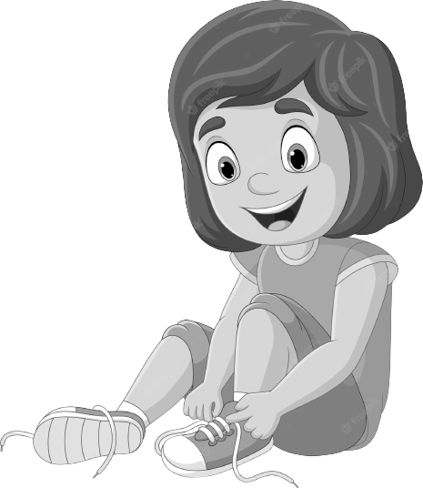
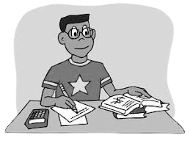
Start
to
Finish
The Goal Setting Marathon:
Visualizing Your Starting Point

Slide 2
Mile 2
Mile 4
Halfway there…
1 more mile…
Find your momentum…
Road Block!
How will you pivot?
Check your pace…
Road Block!
How will you pivot?
What is your ultimate finish line moment?
Mile 1
Mile 3
Finish Line
The Goal Setting Marathon: Finding your Pace
Notes:
Directions:
Challenge participants to establish a SMART goal as their “finish line moment” – this is their ultimate end goal.
Ex. I want to earn As on my Report Card
Ask participants to think backwards about what it might look like for them to get to their “finish line.” What steps might they need to take to achieve that end goal?
Ex. Attend school daily, complete HW on time, practice new study techniques, self-advocate when they need assistance
Participants should add each “smaller goal” to the mile markers on the Marathon time line

Slide 3
Goals Brainstorm

Slide 4
Mile 2
Mile 4
Mile 1
Mile 3
Finish Line
The Goal Setting Marathon: Finding your Pace

