Slide 1
Alice Deal Community Association
General Meeting-September 29, 2021

Slide 2
AGENDA
Welcome
Approval of Minutes from General Meeting – June 9, 2021
Introduction to ADCA Board for SY2021-2022
Principal Update
IB Coordinator

Slide 3
AGENDA
LSAT Update – LSAT Representative
What’s New with the ADCA and other updates
Treasurer’s Update
Guest Speaker – Paige Trevor, Certified Parent Educator

Slide 4
Welcome by ADCA Co-Presidents
Keri Sikich
Shannon Behm

Slide 5
Action Item
Request for approval of minutes from General Meeting - June 9, 2021
Dara Goldberg – Recording Secretary

Slide 6
Introduction to ADCA Board
Quick intro from each ADCA Board Member
Name
Child’s Name & Team

Slide 7
LSAT Update
LSAT Parent Representatives
Gwendolyn Washington - Chair
Richard Pohlman
Elizabeth Stuart
Shelley Vanneman

Slide 8
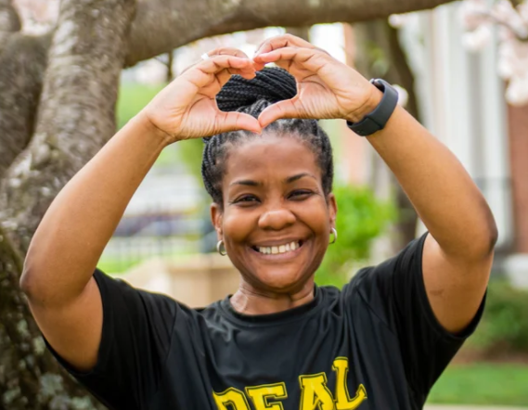
Principal Update – Diedre Neal

Slide 9
International Baccalaureate ~ IB Program at Deal
Caitlin Daniels – IB Program Coordinator

Slide 10
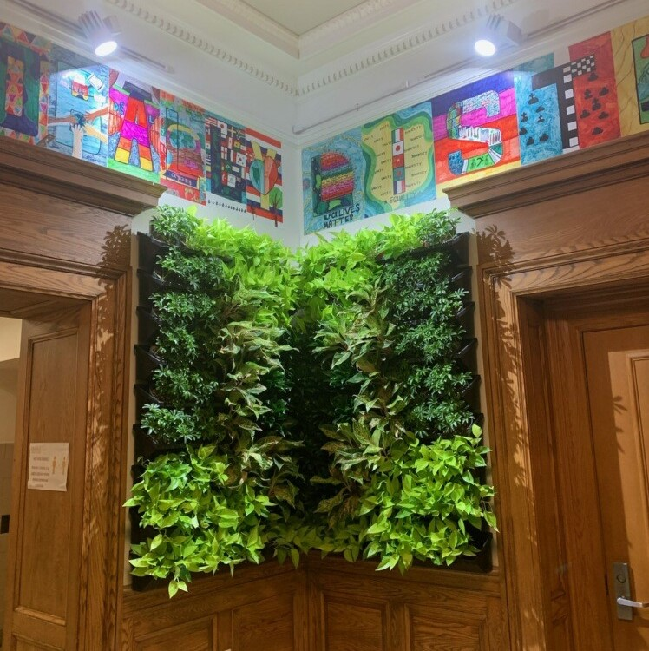
What’s New with the ADCA & Other Updates
New Website!
www.alicedealmiddleschool.org
Green Wall a student lead initiative!

Slide 11
Donation Drive! Still time to donate - thru October 31st

Slide 12
What’s New with the ADCA & Other Updates
Anti-Bias Anti-Racism Initiative – ABAR
Join the meeting on October 7th at 6:30pm
Author Series – Alyssa Bermudez – Big Apple Diaries
October 19th at 6:30pm
Food Drive & Community Day
November 6th 10am – 1pm
Nando’s Peri Peri – Give Back Night [40% of proceeds]
November 9th

Slide 13
Treasurer’s Update
Astrid Ruggeri
John Bernards

Slide 14
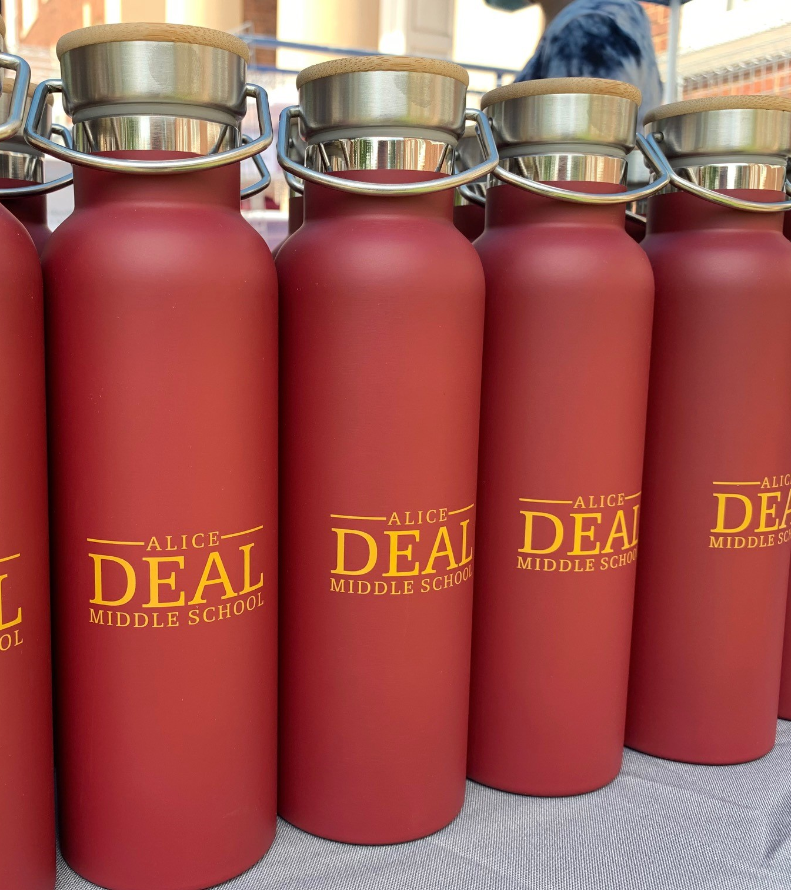
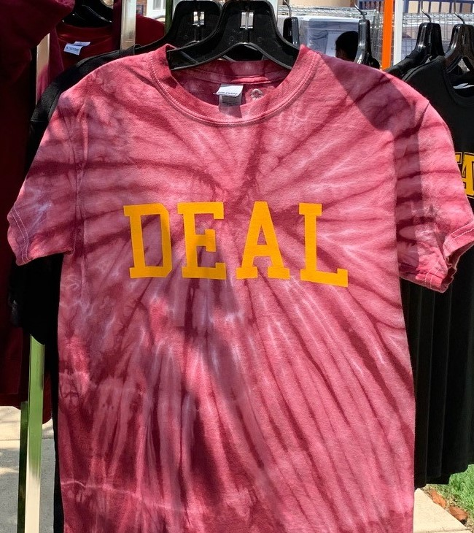
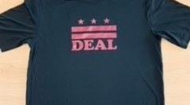
Deal Gear ~ Show your Deal Spirit!

Slide 15
Thank You! Please contact us at: adcapresident@gmail.com www.alicedealmiddleschool.org

